Slide 1
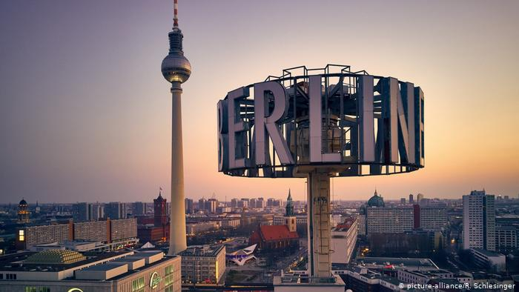

Airbnb vs Berlin
What data tell us ?

Slide 2
Content
Origin of dataset
Hosts
Density
Type of rooms
Notes:
We are going to see descriptive information about hosts, density of the city and type of rooms

Slide 3

Origin of dataset
Has been published on 12th of March 2021
Contains 19858 listings
Notes:
The data set has been taken from `Inside Airbnb`, which is public platform containing Airbnb datasets for many cities.
The data set has been published on 12th of March 2021 and contains almost 20 thousend listings

Slide 4
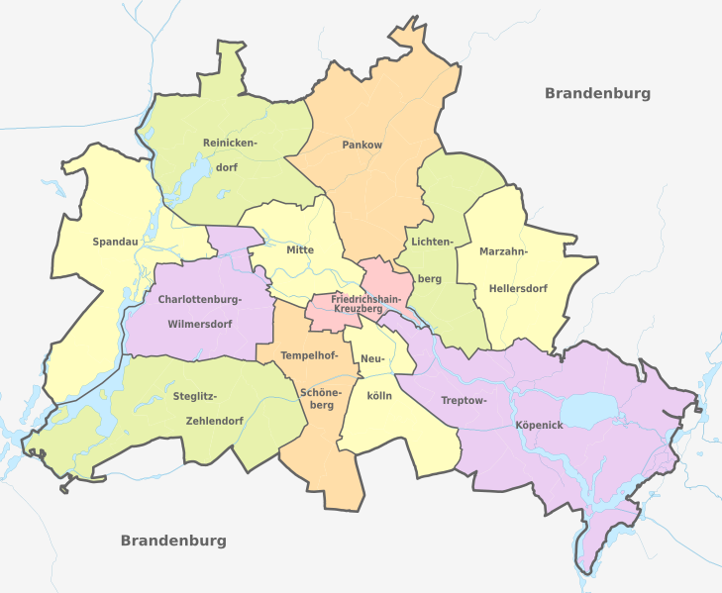
Notes:
This is a map of berlin with its 12 districts regions.

Slide 5
Hosts
Berlin has 15907 hosts
Super host - 2132
Normal host - 13016
Unknow - 759
Notes:
Berlin has 15907 hosts, around 2k of them are super host, 13 thousand normal host and for rest there is no information in our dataset.

Slide 6
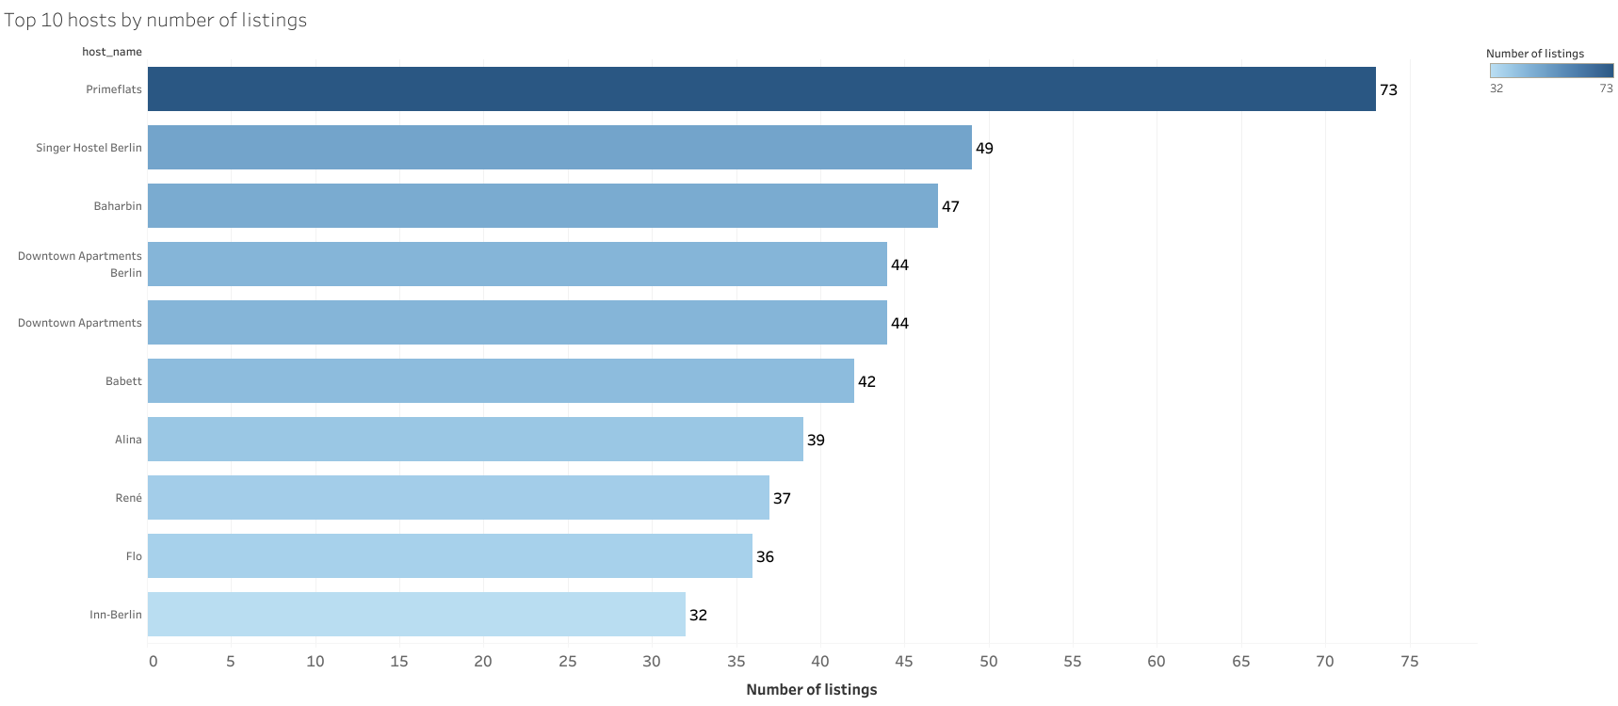
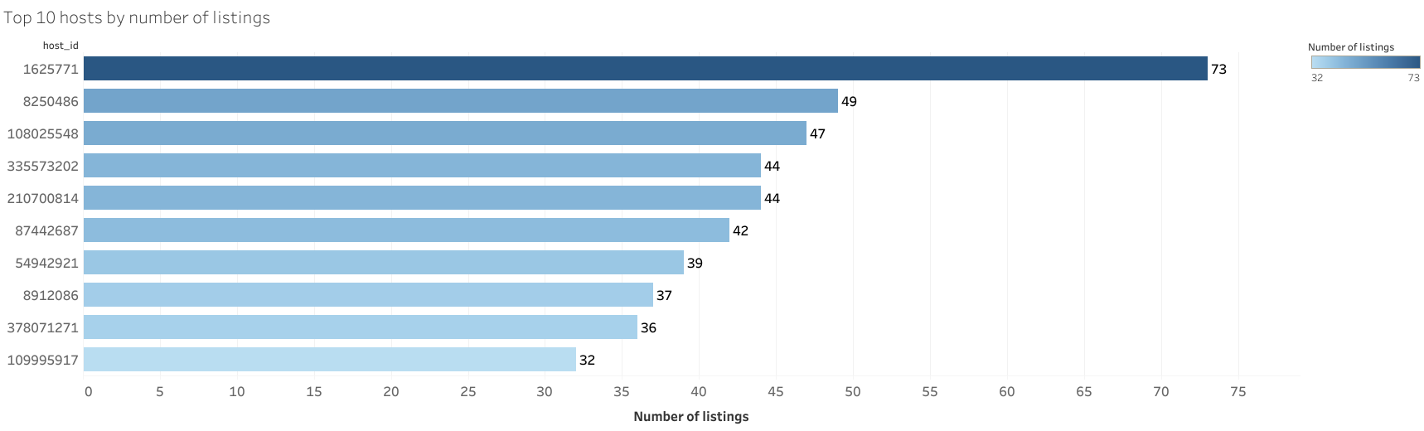
Top 10 host by listings
Notes:
These are top 10 host with most listings.
On horizontal axis are number of listings, on a vertical axis hosts names
As we can see the top host is Primeflats with 73 listings
It’s interesting to say that these hosts represents only 2 percent of the whole listings. Basically this means there are really huge competition, especially between hosts with one or two listings.

Slide 7
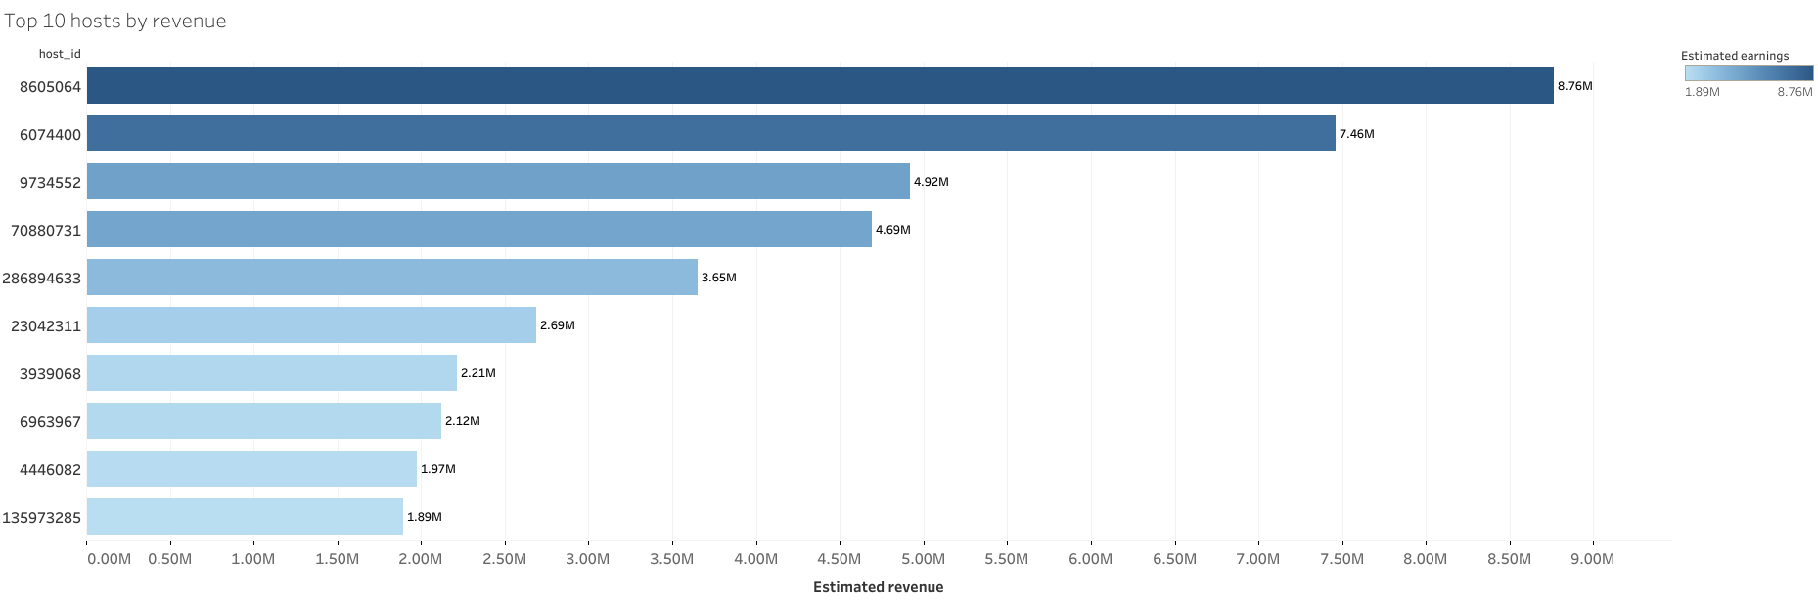
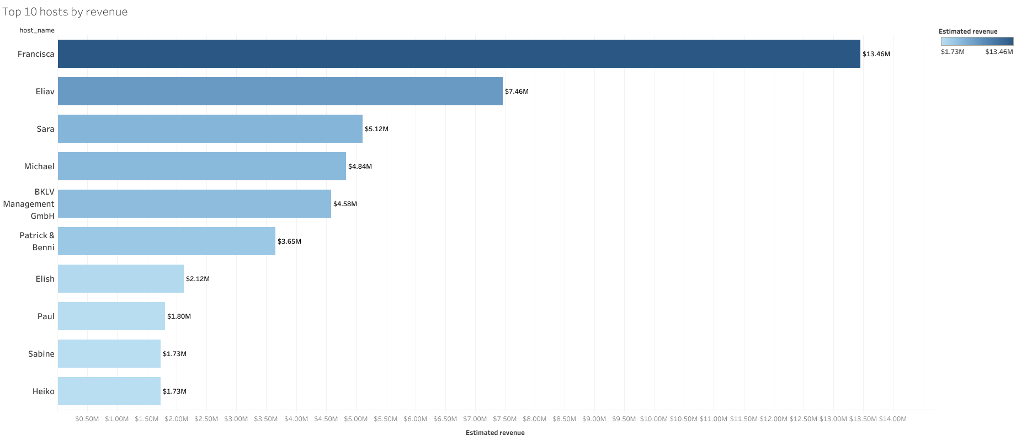
Top 10 by total revenue
Notes:
These are top 10 host by total revenue,
The top host is Francisca with estimated revenue of more than 13 milions
common sense says that the more listings you have the more revenue you made, but in this case there is none of top 10 host by listings
#The total revenue has been estimated by number of reviews and number of minimum nights

Slide 8
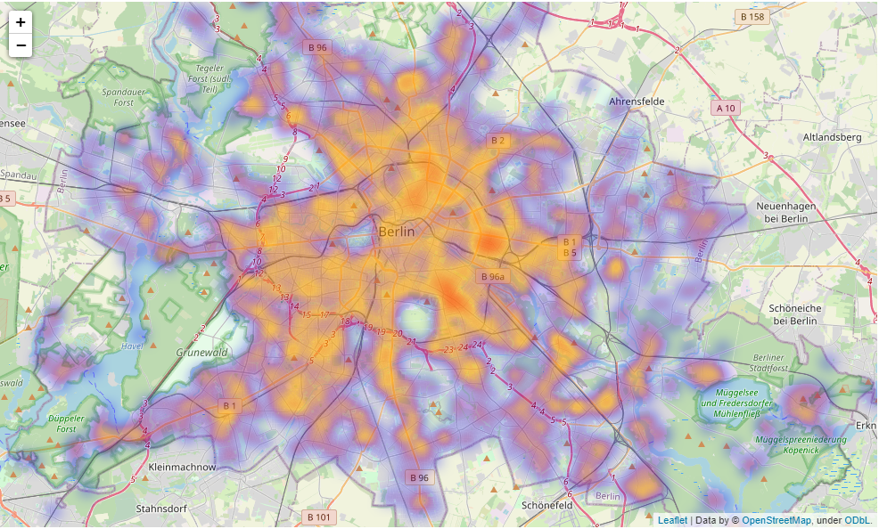
Density – heatmap
Notes:
this heatmap represents the density of accommodation
the redder, the more accommodations there are
We can clearly see that the closer we are to the center, the more housing there are

Slide 9
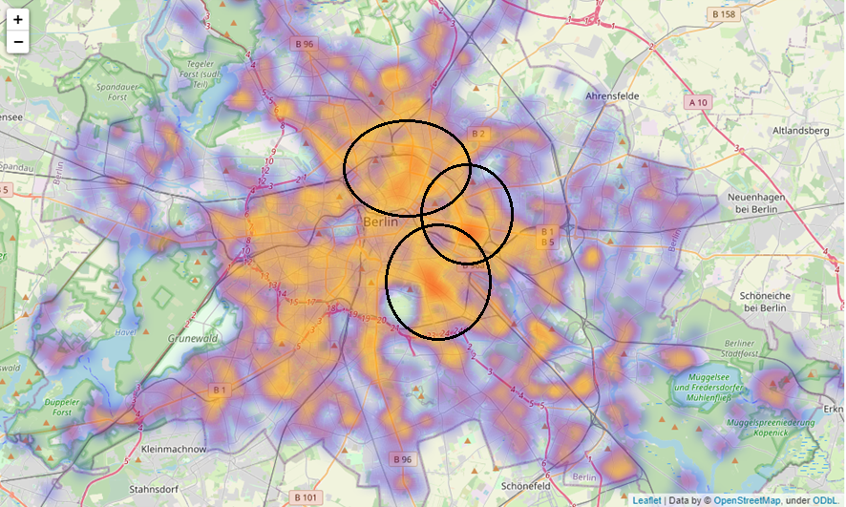
Density – heatmap
Notes:
And ofcourse these three regions are with most density

Slide 10
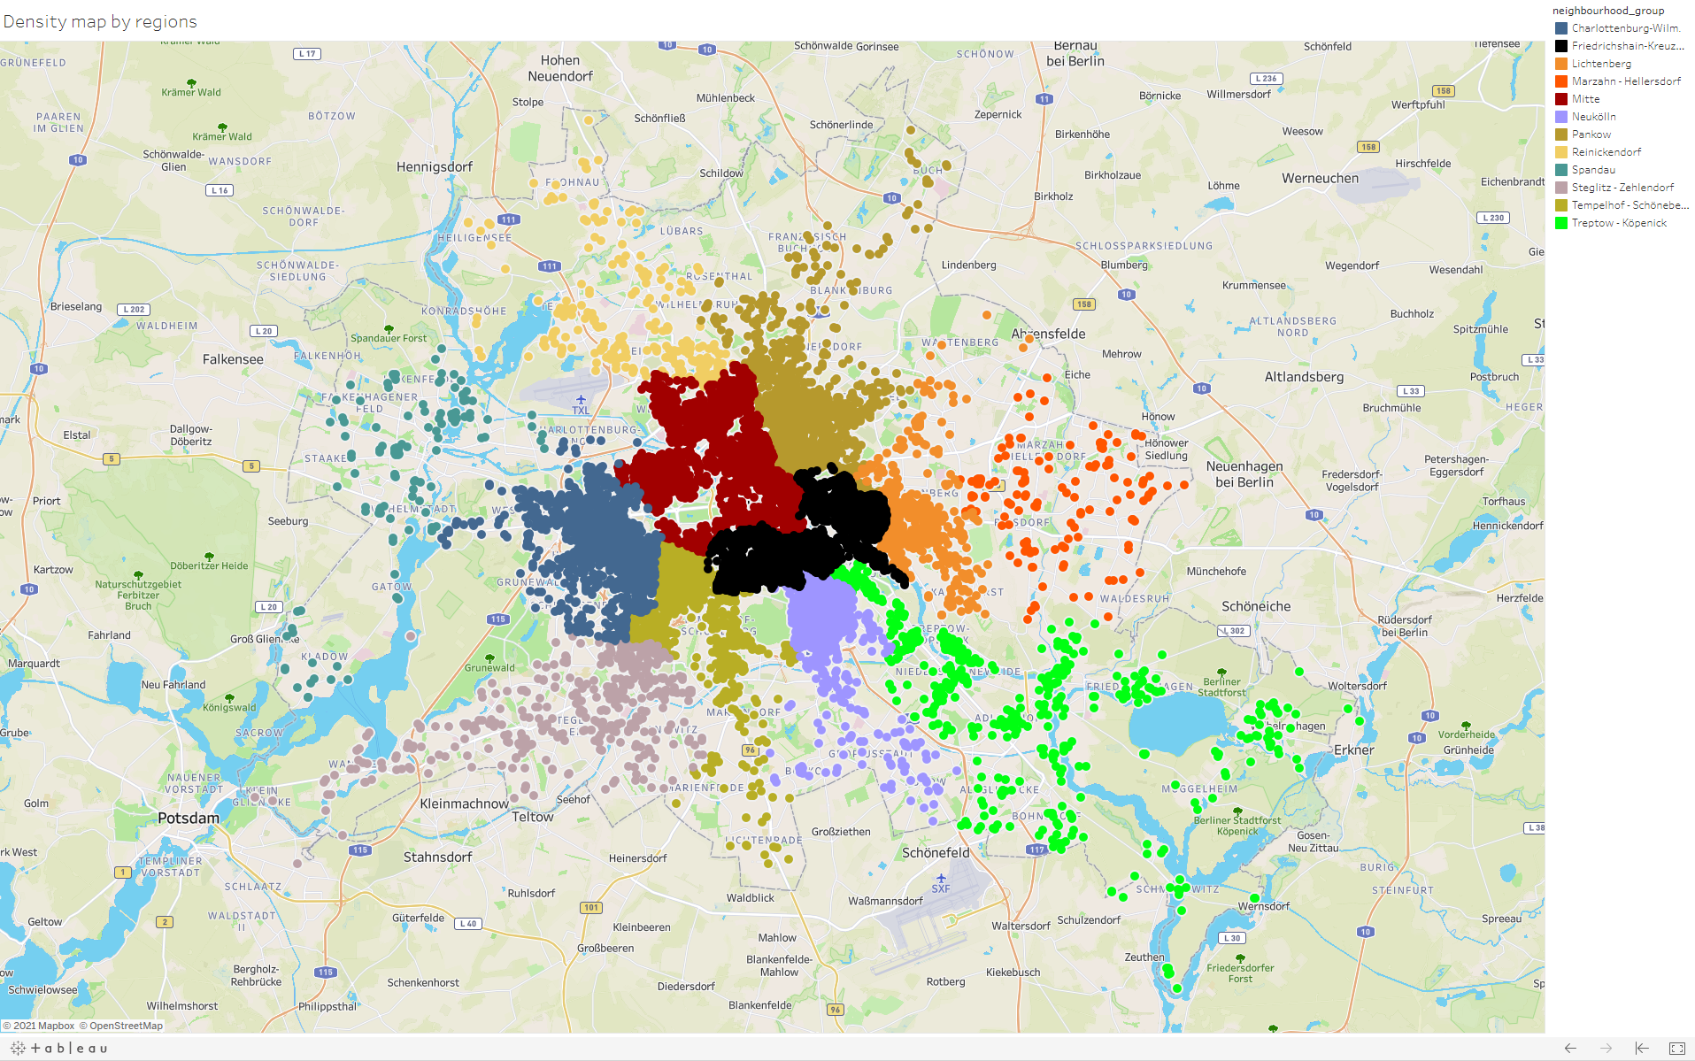
Density map by regions
Notes:
Friedrichshain-Kreuzberg 4466
Mitte 4340
Pankow 3098
Neukölln 2706
Hier we can see the density by each regions.
Acording to the numbers the most density regions are Mitte in red and Friedrichshain-Kreuzberg in black with a difference of less than 100 listings

Slide 11
What are the types of rooms?
Entire place (home/apartment)
Private rooms
Shared rooms
Hotel rooms
Notes:
There are 4 type of rooms
Entire place
Private Rooms
Shared rooms
Hotel rooms
Entire place
Entire places are best if you're seeking a home away from home. With an entire place, you'll have the whole space to yourself. This usually includes a bedroom, a bathroom, a kitchen, and a separate, dedicated entrance. Hosts should note in the description if they'll be on the property or not (ex: "Host occupies first floor of the home"), and provide further details on the listing.
Private rooms
Private rooms are great when you prefer a little privacy, yet still value a local connection. When you book a private room, you'll have your own private room for sleeping and may share some spaces with others. You might need to walk through indoor spaces that another host or guest may occupy to get to your room.
Hotel rooms
Whether private or shared, hotel rooms provide a level of service and hospitality associated with traditional hotels. The rooms are available in boutique or lifestyle hotels, hostels, bed and breakfasts, or similar properties. They typically include vibrant common areas and rooms with unique touches.
Shared rooms
Shared rooms are for when you don't mind sharing a space with others. When you book a shared room, you'll be sleeping in a space that is shared with others and share the entire space with other people. Shared rooms are popular among flexible travelers looking for new friends and budget-friendly stays.
In addition to looking for places to stay based on room type, you can also filter searches to look for something more specific like a pool or to browse listings that are good for traveling with a family.

Slide 12
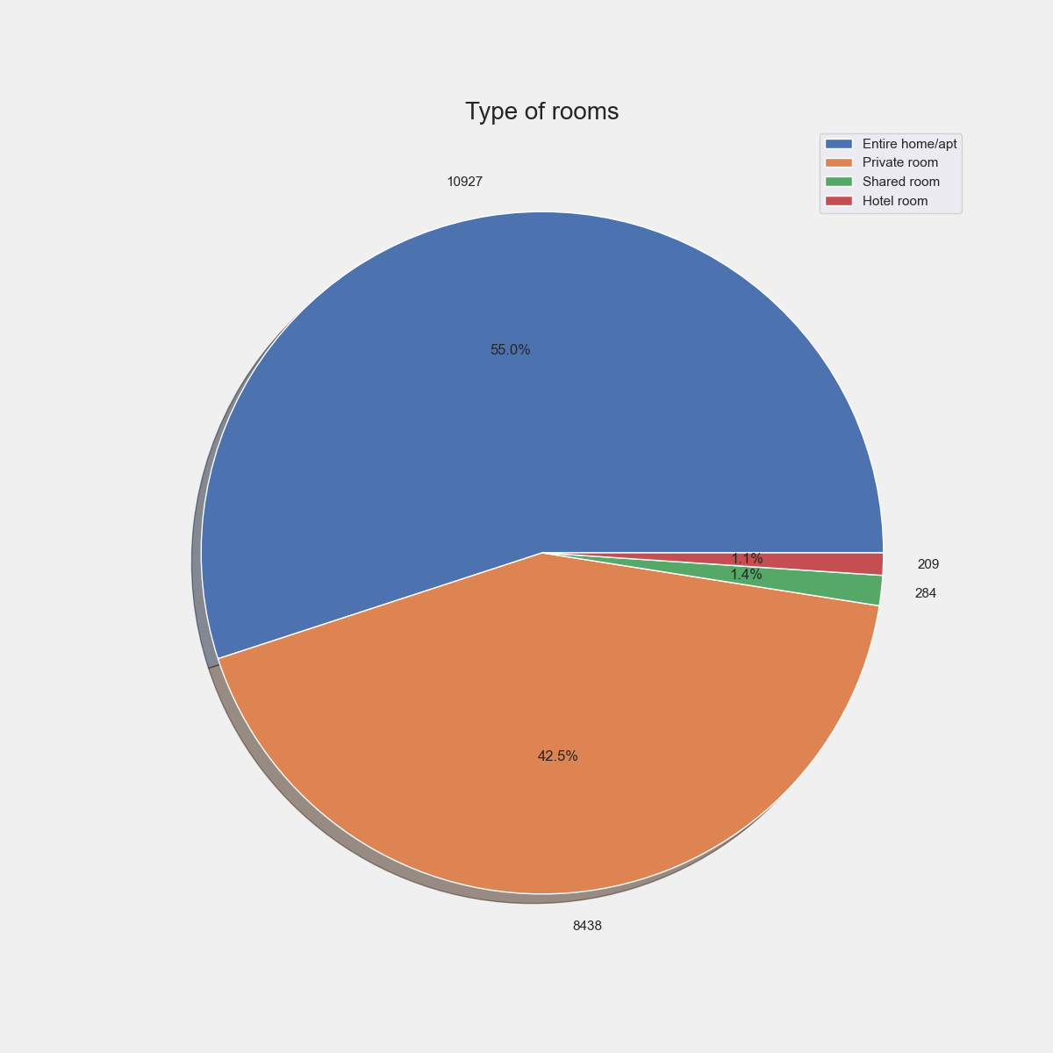
Notes:
Entire home/apt 10927
Private room 8438
Shared room 284
Hotel room 209
The most frequency type of room is entire place, followed by private room

Slide 13
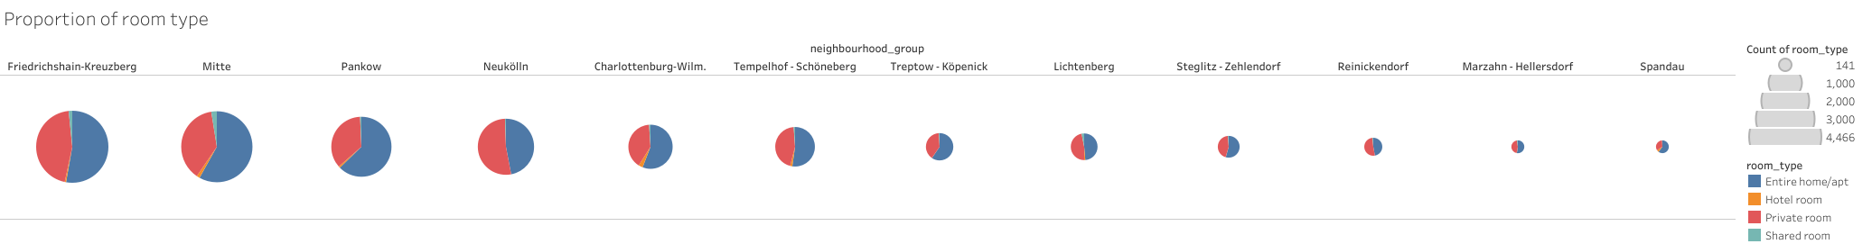
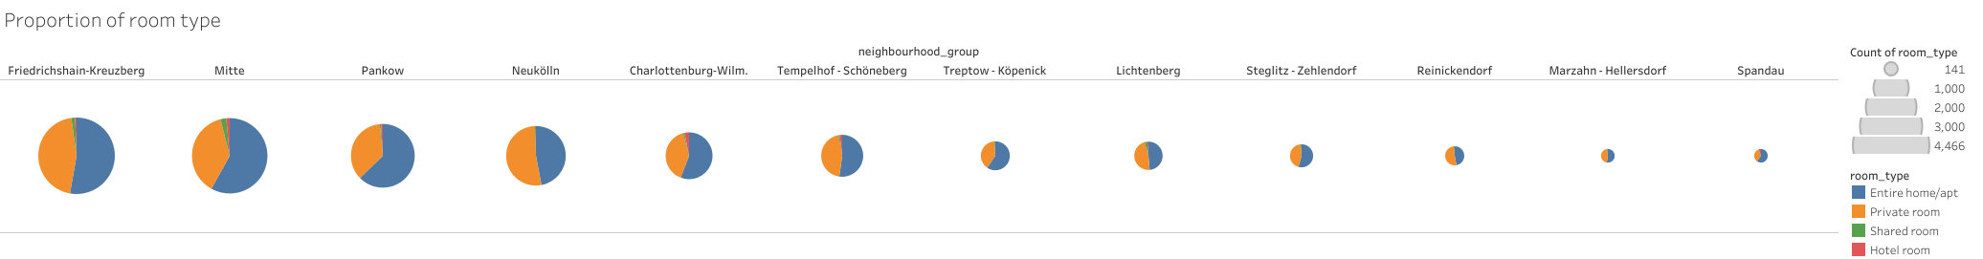

Slide 14
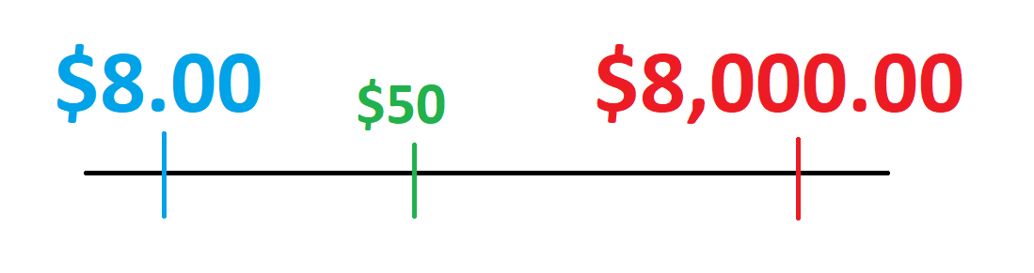
Accommodation
The cheapest is $ 8.00 per night. (Private / shared room in Friedrichshain-Kreuzberg, Neukölln)
The most expensive is $ 8,000.00 per night. (Private room in Prenzlauer Berg Nord)
Median price is $ 50
Notes:
Accommodation
The cheapest place is for 8$ per night
Median price is 50$
#The cheapest price is 8 dollars whereas the most expensive is 8 thousand.

Slide 15
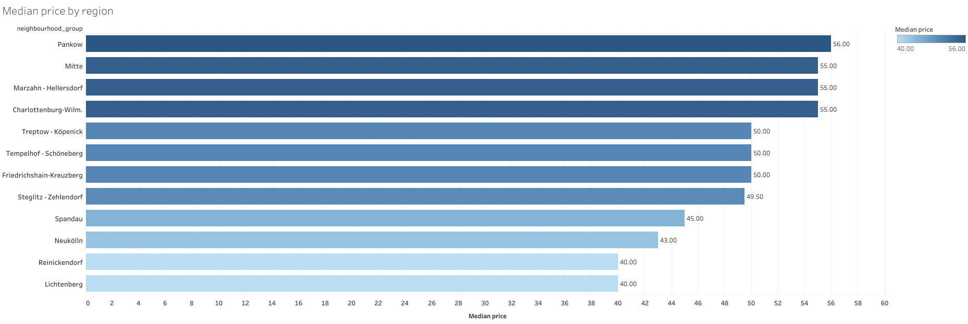
Cheapest region based on median
The most expensive region based on median
Notes:
Hier we can see the median price by each region.
there is not much difference between the prices by regions. the most expensive region is Pankow with 56$ and the cheapest are Reinickendorf and Lichtenberg with 40$

Slide 16
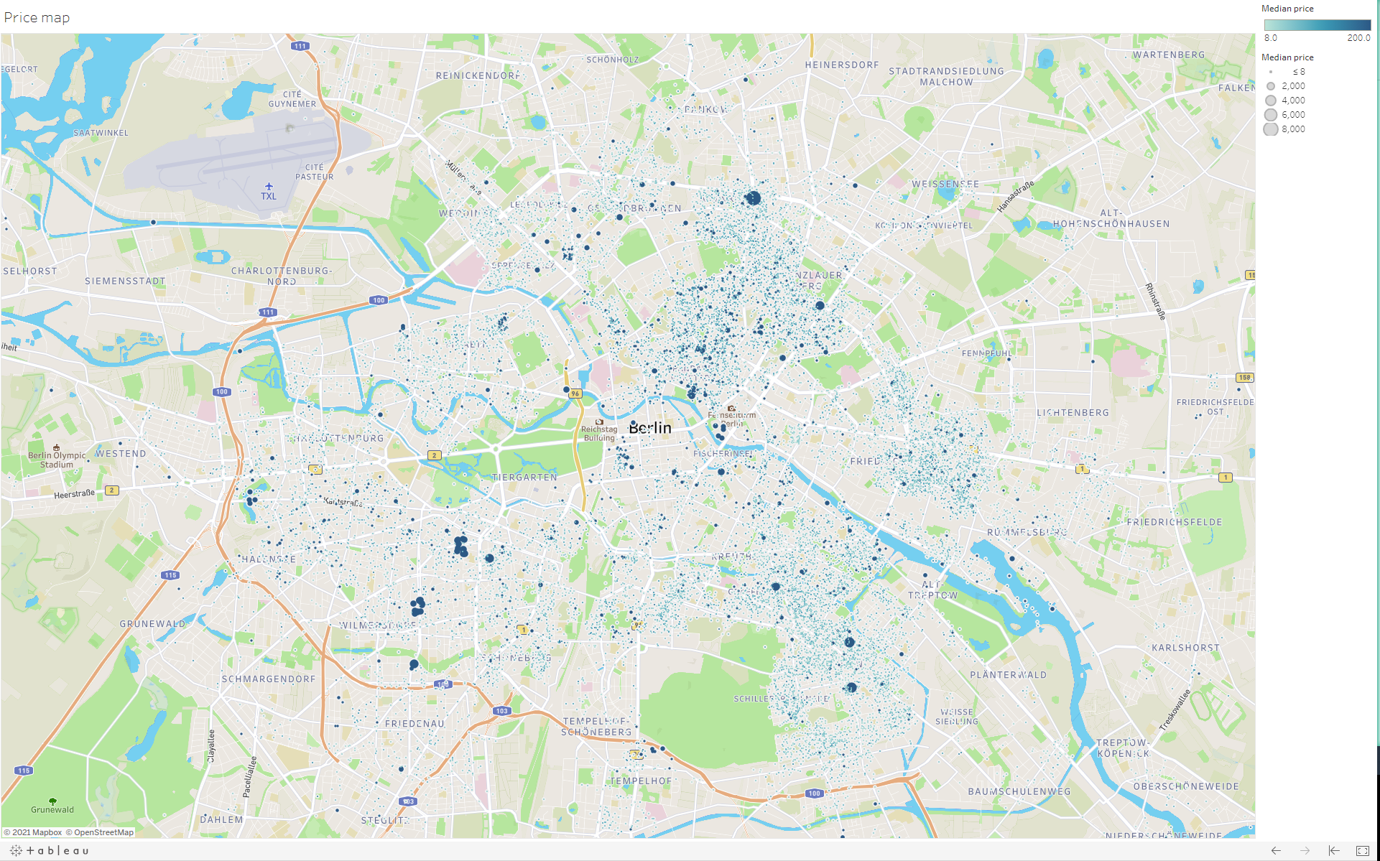
Notes:
From this price map can be seen, that the darker and bigger the dot, the more expensive are price per night . The farther we are from the city center, the lower the price.
Basically, prices in western and eastern regions do not differ much, but the eastern ones are still a little more expensive

Slide 17
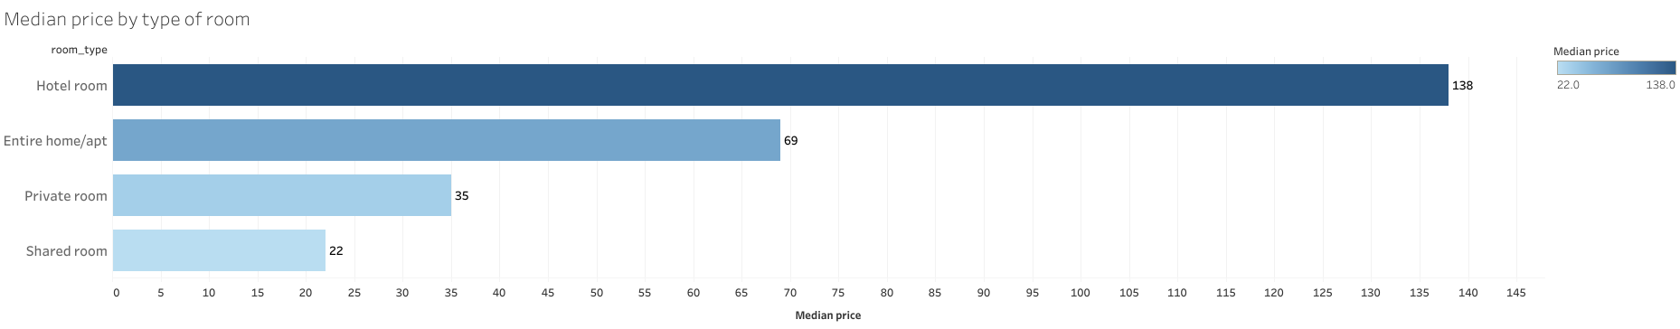
Notes:
This is the median price by type of room.
Here the prices vary a lot, but there is nothing to surprise us, the most expensive type of room is hotel room and the cheapest is a shared room.

Slide 18
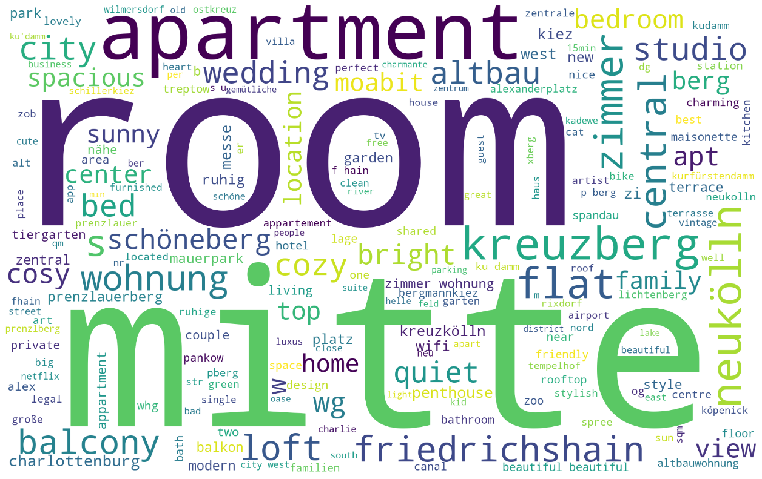
Notes:
last but not least
These are 200 hundert most frequency words in accommodation titles.
Most often they include, location, type and some descriptive adjectives of accommodation.
#In this case the most often word is mitte folowerd by room and apartment. Maybe because mite is one of the most density regions, and room is included inside the three type of rooms like hotel room, private room, shared room

Slide 19


Notes:
Than you for your attention keep cal and Airbnb on!

